Slide 1

ACADEMIC ERP
Presented By:
VIVID International

Slide 2

About VIVID
We are VIVID International a leading Education Management System originator of the country and our academic ERP is the a leading software architecture designed and advanced by our core developers that we already have successfully implemented in some of Country’s most fabulous academic institutions. VIVID International is a privately owned company in Bangladesh in 2018. Since its inception, VIVID team has been providing quality IT solutions to companies solving their ever challenging problem of aligning IT with business directions. Our biggest strength lies in exploiting the talented offshore developer team efficiently managed by our experienced USA based project manager and software architects.

Slide 3
Our Vision
Our vision is bringing software for every single school of the country. We work hard to achieve a long term and sustainable corporate victory through providing prominent services and co-operate educational institutions making their professional lives as simple as possible. We believe in comprehensive school management system and administrative software that is highly beneficial for all types of schools or colleges by controlling and managing their day-to day activities.

Slide 4
Our Mission
Our mission is to promote your Institution to a whole new level by positioning it into a highly technologically developed standard. We work closely with our clients to ensure everyone agrees on the goals of the project and discuss how to make it deliverable and how success will be defined. We have found that our systematic progression is the key to providing a well-defined set of working strategies ensuring timely project completion and ultimately securing a solution that allows our customers achieving their business goals. We never move from our core and work to benefit education through technology.

Slide 5






Our Inspirations

Slide 6
What Makes VIVID Special
We believe modern technology should enhance or facilitate education. To do so, we have used the latest technologies to enhance user experience and flexibility. We studied the available software and solutions in the educational arena in Bangladesh. We also have collected opinions and advices from large and small Schools or Colleges and asked more than hundreds of teachers and students about their own thoughts about Education Management Software before starting this project which has made us more intellectual and proficient to create a software of more capability and user friendliness.
International Experience
Customization Ability
Smart Developers
Attractive Pricing
Extensive Training

Slide 7

Now come to the focal point
The Academic ERP
Running an institution can be a very daunting task in today’s educational environment. Competition between students leads to competition between Institutions. The basic challenge of an Institution is to centralize, track, and resolve student issues, manage the various academic activities and operations through information in a flawless manner and deliver quality result oriented education. Our system will aid an educational organization to manage both their academic and administrative activities which is always a challenging and time taking as well.

Slide 8

Systems We Offer Under Academic ERP

Slide 9
Dynamic Website
Menu Management
Banner Picture management
Photo/Video Management
Manage Academic Calendar
Mange Academic Events
Chairman/Principal’s Message
Manage Notice and News

Slide 10
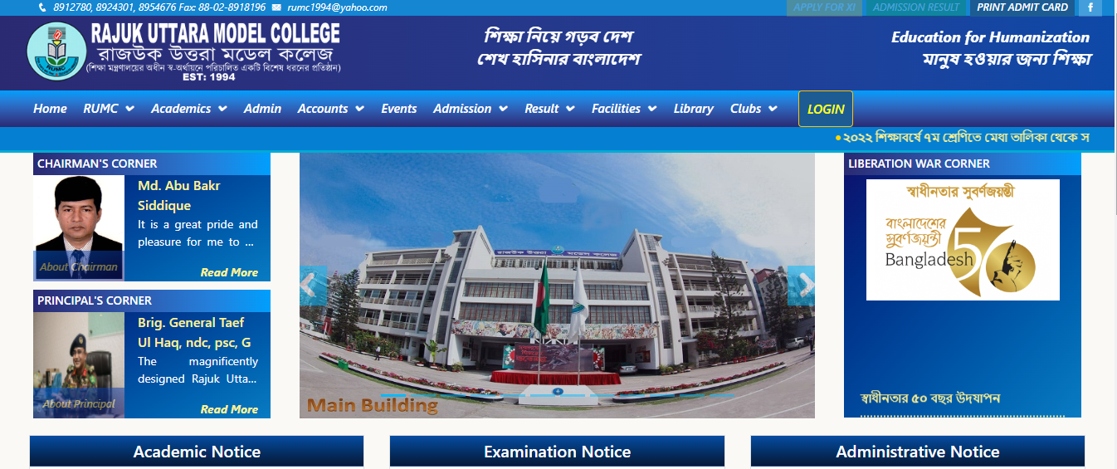
Dynamic Website

Slide 11
Online Tuition Fees Collection System
Modules
Payment Through TAP, Bkash, Rocket Or Any Other Mobile Banking System
Payment Through Debit Or Credit Card
Head Wise Dues Load
Display Of Waiver Amount
Display Of Fine Amount
Payment History
Save And Download Pay-Sleep Online

Slide 12
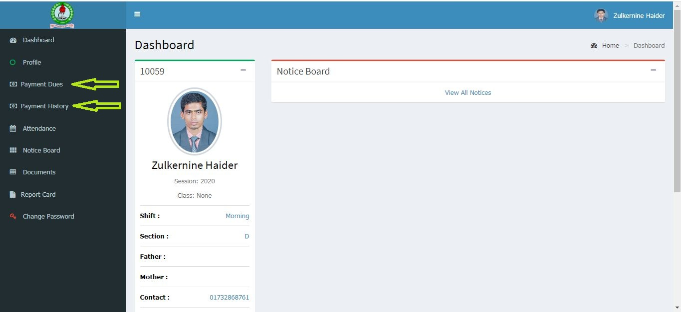
Online Tuition Fees Collection System

Slide 13
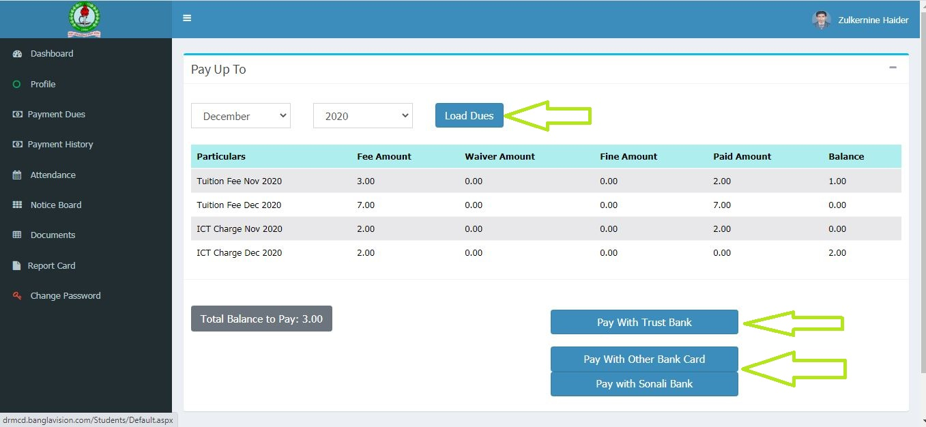
Online Tuition Fees Collection System

Slide 14
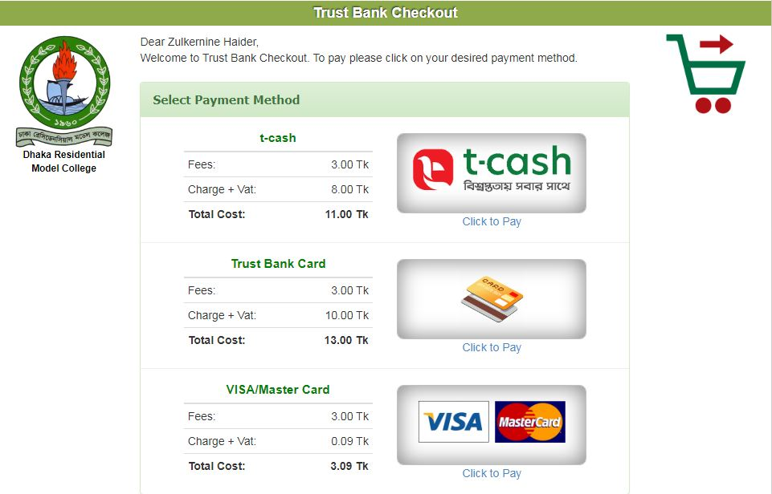
Online Tuition Fees Collection System (Tcash)

Slide 15
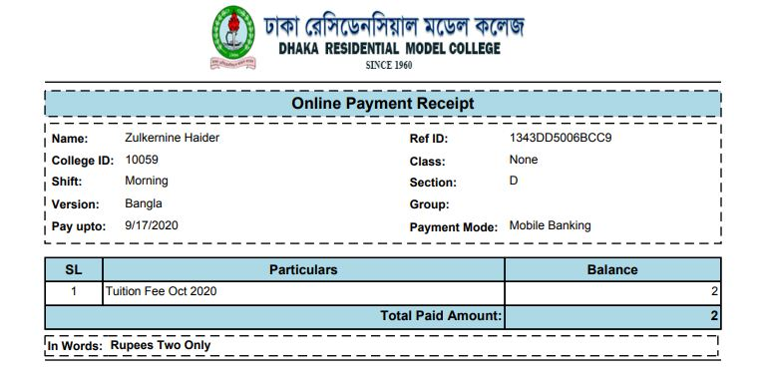
Online Tuition Fees Collection System (Pay-Sleep)

Slide 16


The Process of Online Payment System (Tkash)
GUARDIAN
Student
Or
Guardian
Login into their portal
Click on Payment Dues
Select month or year then click on Load Dues
Click on
Pay With Trust Bank
Select payment method
(T-Cash)
Click on Go to Main Page to be back to main page
Click on Download Pay sleep to download
Enter Authorization Code & click on Process Transaction
Enter T-cash A/C number & pin then click on Send Authorization Code

Slide 17
The Process of Online Payment System (Bkash)
Login into the given profile
Visit the Website
Go to Payment History for Future Needs
Online Payment System
Click on Payment Dues
Download Pay-sleep and Save
Select Months to Pay Fees
Click on Pay With Bkash Payment
Enter Your Bkash Account Number and Confirm
Enter Verification Code and Click on Confirm
Enter Your Pin and Click on Confirm

Slide 18
Dynamic Fees Collection System
Dynamic Fees Types Setup
Assign Tuition Fees
Manage Discounts
Manage Fines
Fees Printing Single or Multiple
Student Wise Fees Details
One Click and Partial Fees Collection
Versatile Fees Collections Reports and Many More

Slide 19
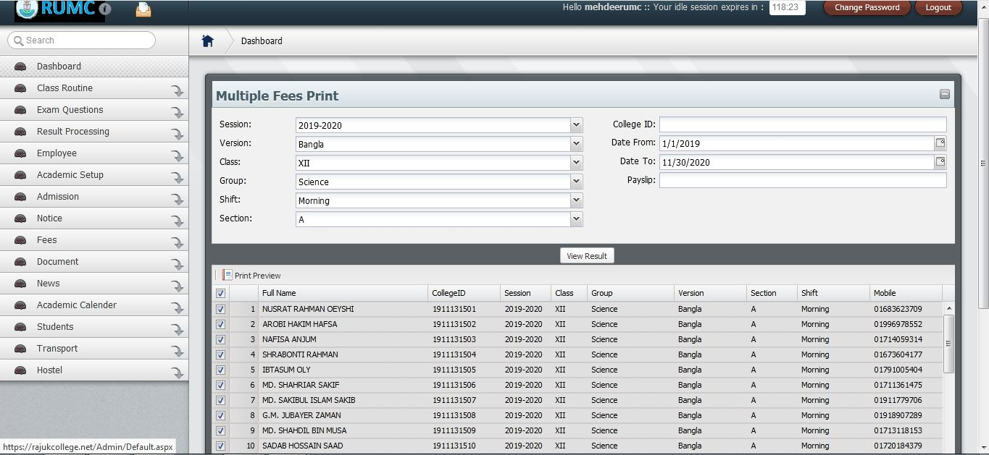
Dynamic Fees Collection System (Fees Print)

Slide 20
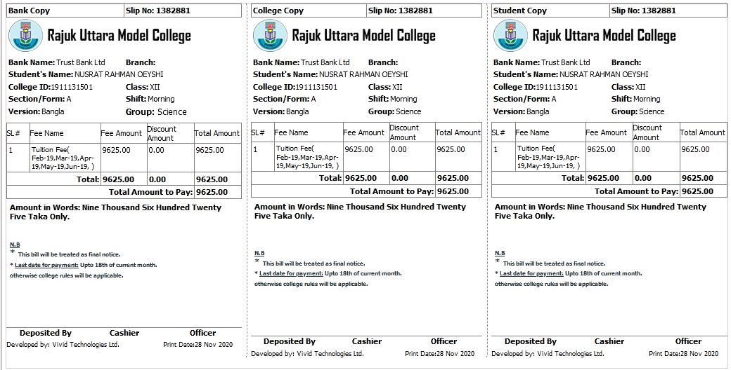
Dynamic Fees Collection System (Fees Print)

Slide 21
Result Processing System
Manage Grades
Manage Exams
Mange Schedule and Setup Marks
Mange Result Setup
Manage Student Marks
Process Results
Manage Exam Comments
Automated Report Card
Automated Tabulation Sheet
Result Analysis Reports
Grade Reports
Archive Results

Slide 22
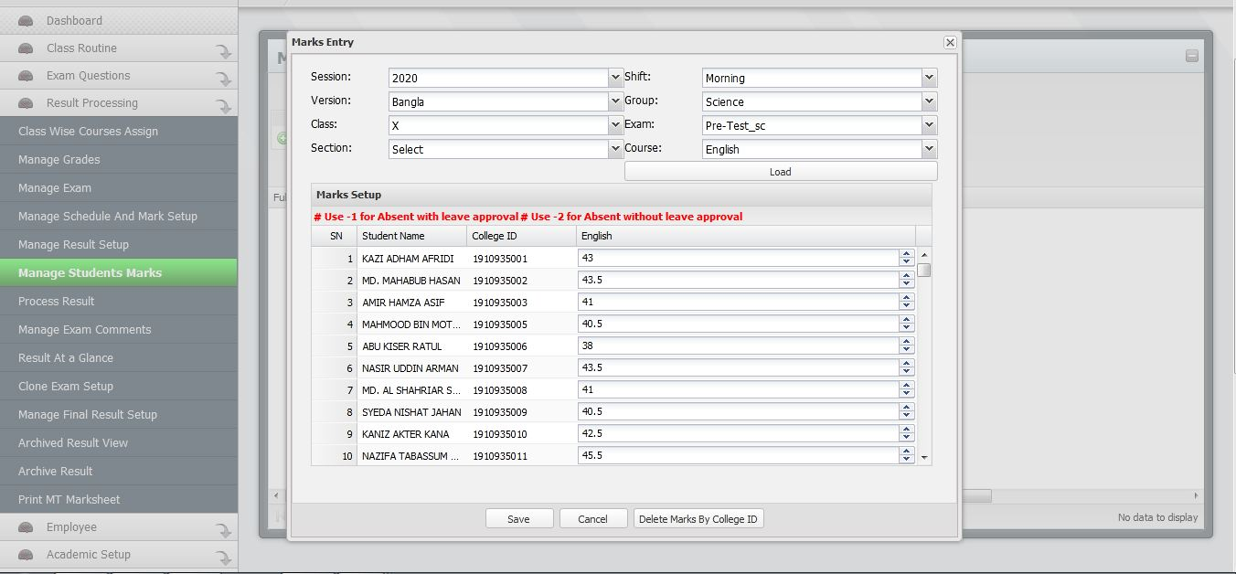
Result Processing System (Marks Entry)

Slide 23
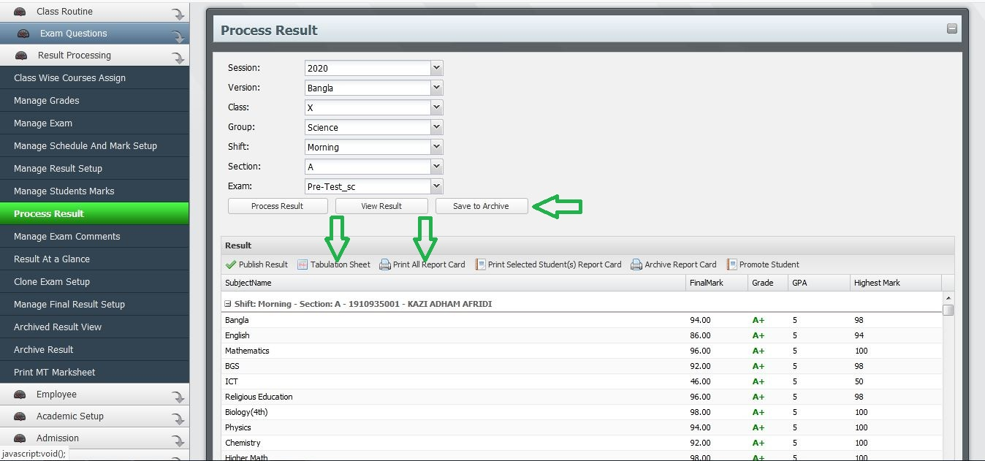
Result Processing System (View Result)

Slide 24
Result Processing System (Result Analysis Reports)
Result At a Glance
Result Sheet
First and Last Ten Students
First Ten Students in Class
Subject Wise Analysis
Subject Wise Fail

Slide 25
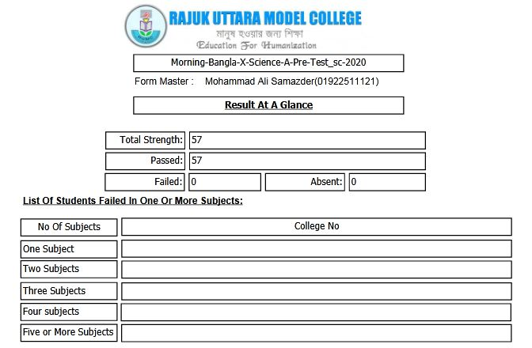
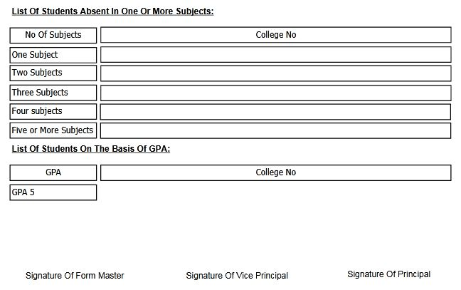
Result Processing System (Result At a Glance)

Slide 26
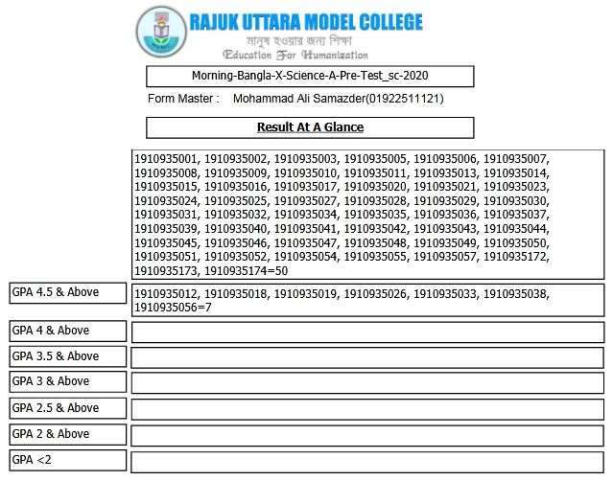
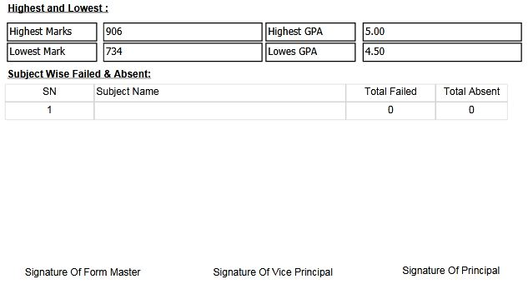
Result Processing System (Result At a Glance)

Slide 27
Portals
Admin Portal
Teacher Portal
Student or Parent Portal

Slide 28
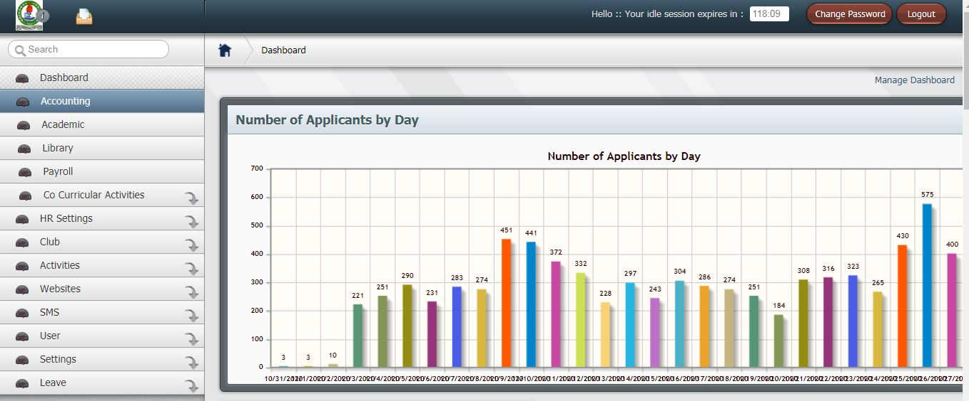
Admin Portal

Slide 29
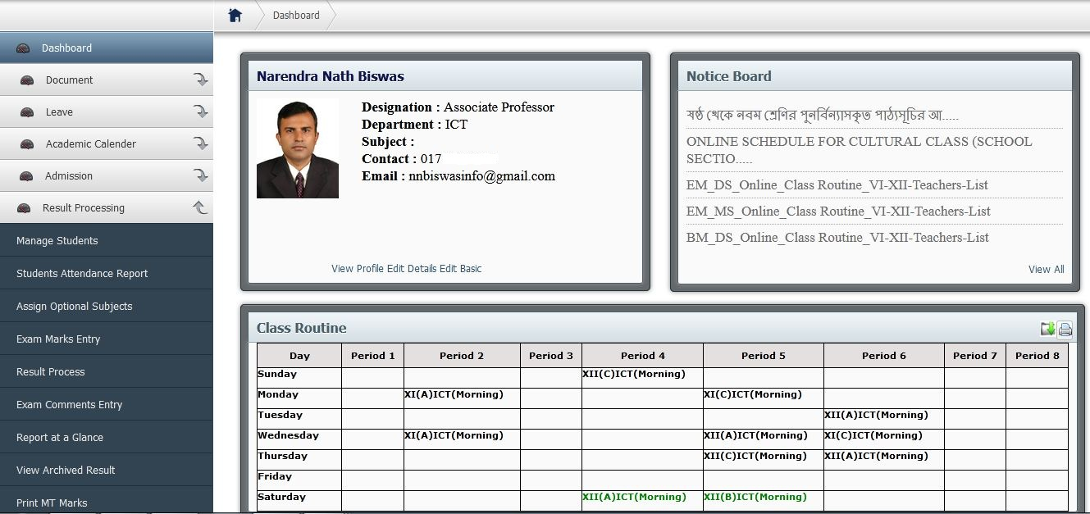
Teacher Portal

Slide 30
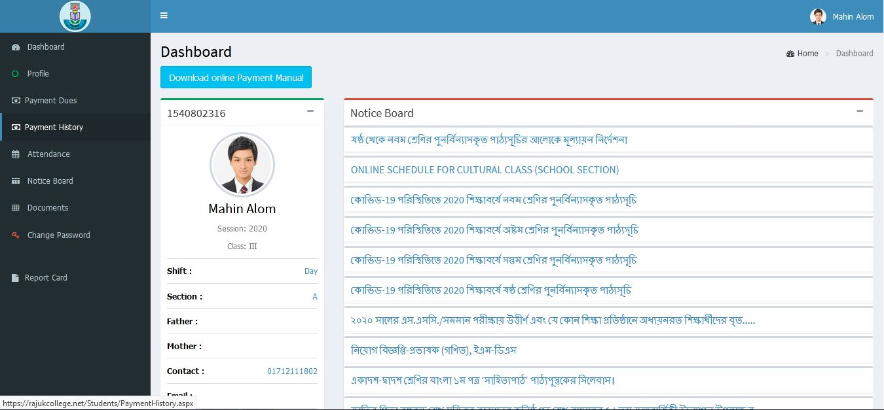
Student or Parent Portal

Slide 31
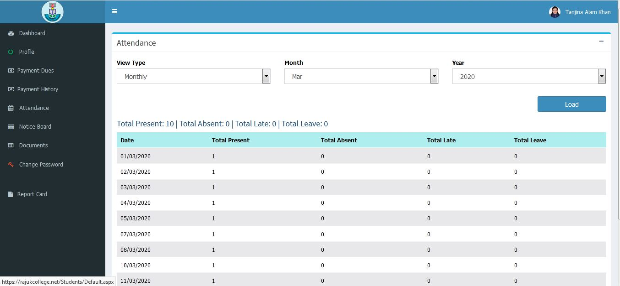
Student or Parent Portal (Attendance Report)

Slide 32
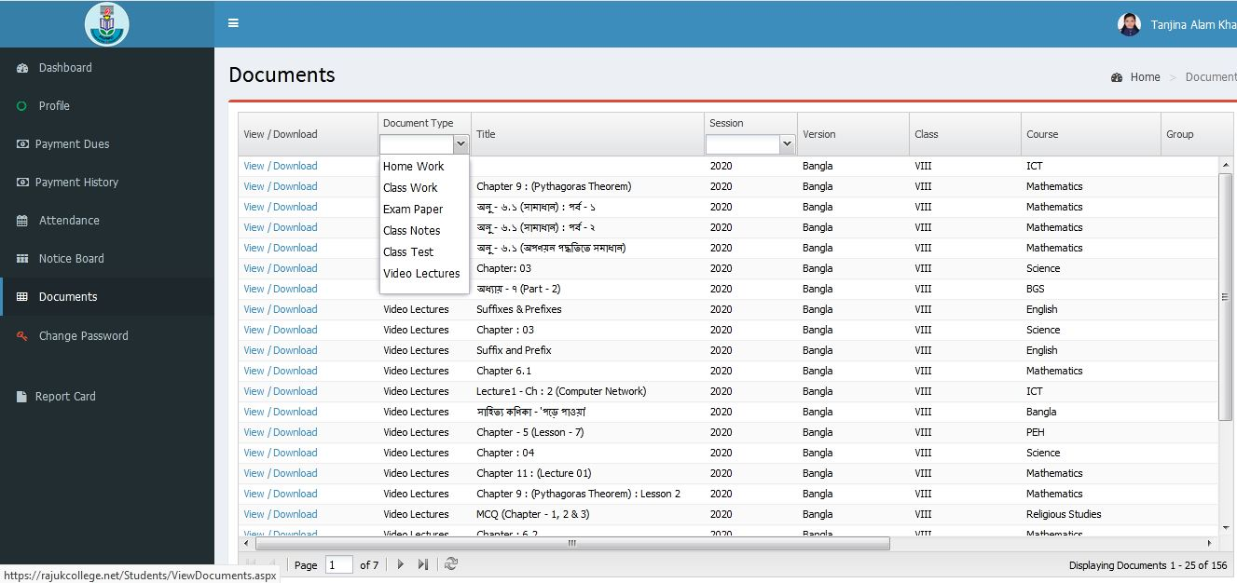
Student or Parent Portal (Documents)

Slide 33
Student Management System
Add, Edit and Import Multiple Students
Manage Students Basic Information
Manage Guardians Information
Manage Attendance
Manage Students Optional Subject
Students Report

Slide 34
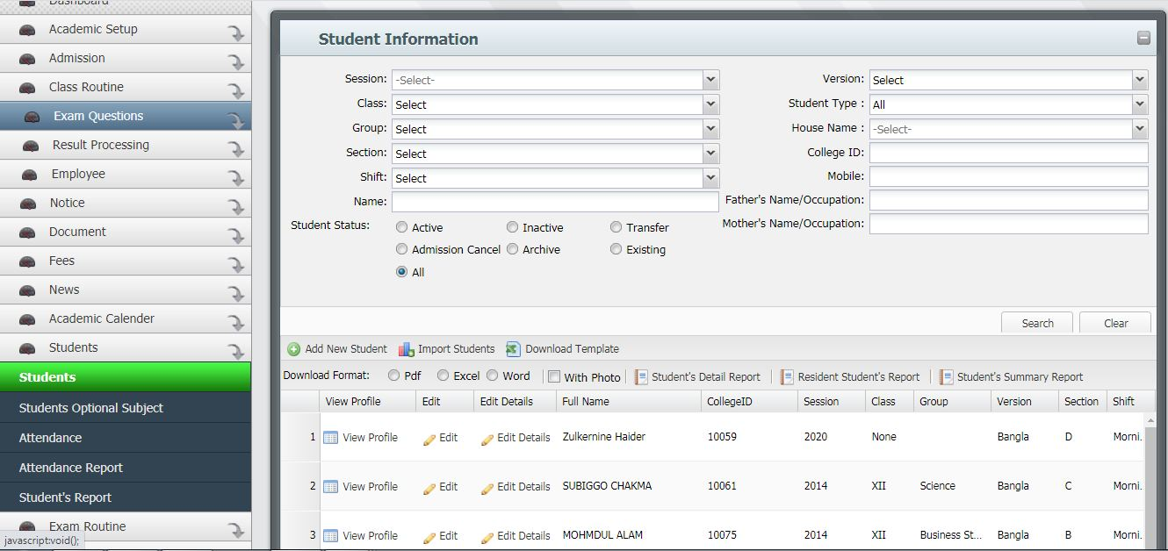
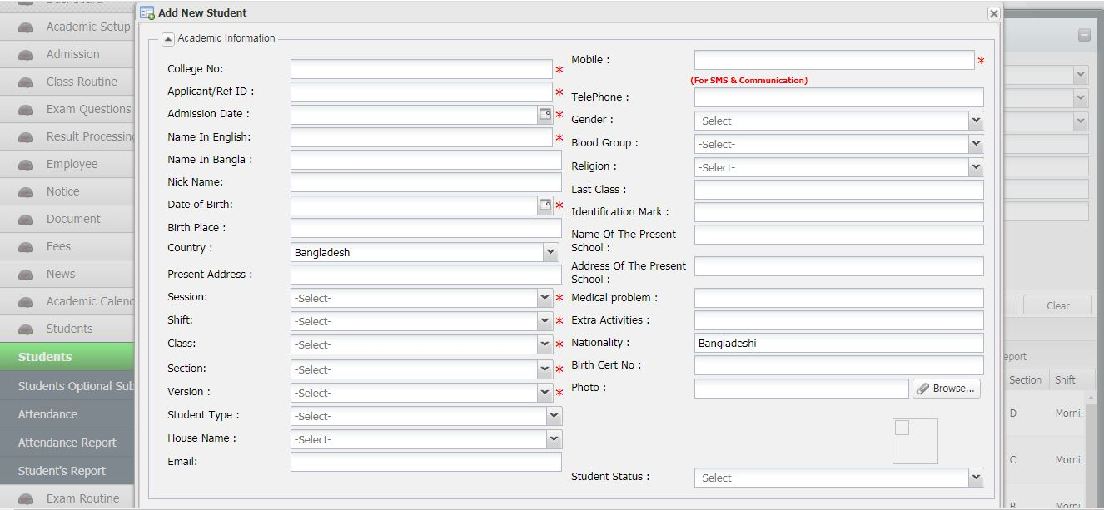
Student Management System

Slide 35
Attendance Management System
View Student’s Previous Attendance Reports
Date Wise Attendance Reports
Month Wise Attendance Reports
Save Attendance Status Without Sending SMS to Guardians
Save Attendance Status With Sending SMS to Guardians
Multiple Attendance Status Including Late, Leave, Absent Period With Comments

Slide 36
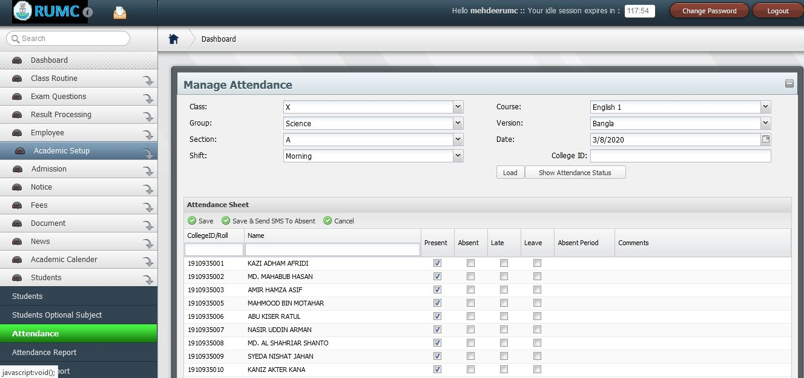
Attendance Management System

Slide 37
Accounting Management System
Master Entry
Vouchers
Voucher Posting Panel
Salary Sheet Generation
Reports of Accounts

Slide 38
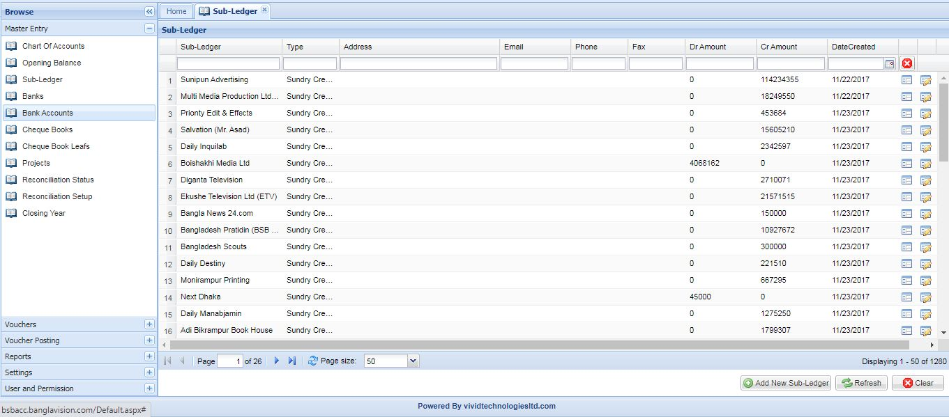
Master Entry (Sub-Ledger)

Slide 39
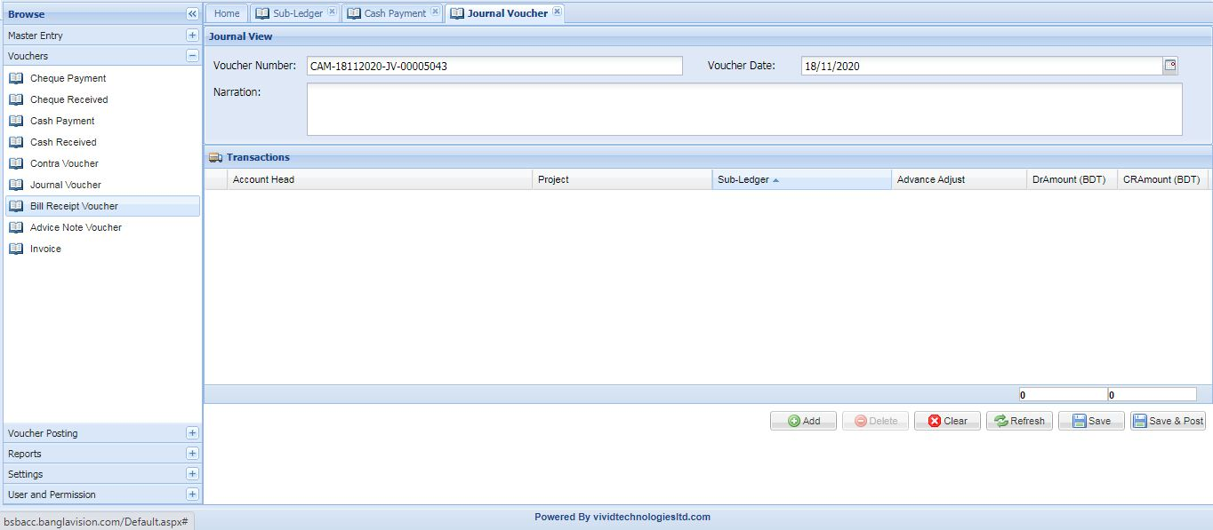
Vouchers (Journal Voucher)

Slide 40
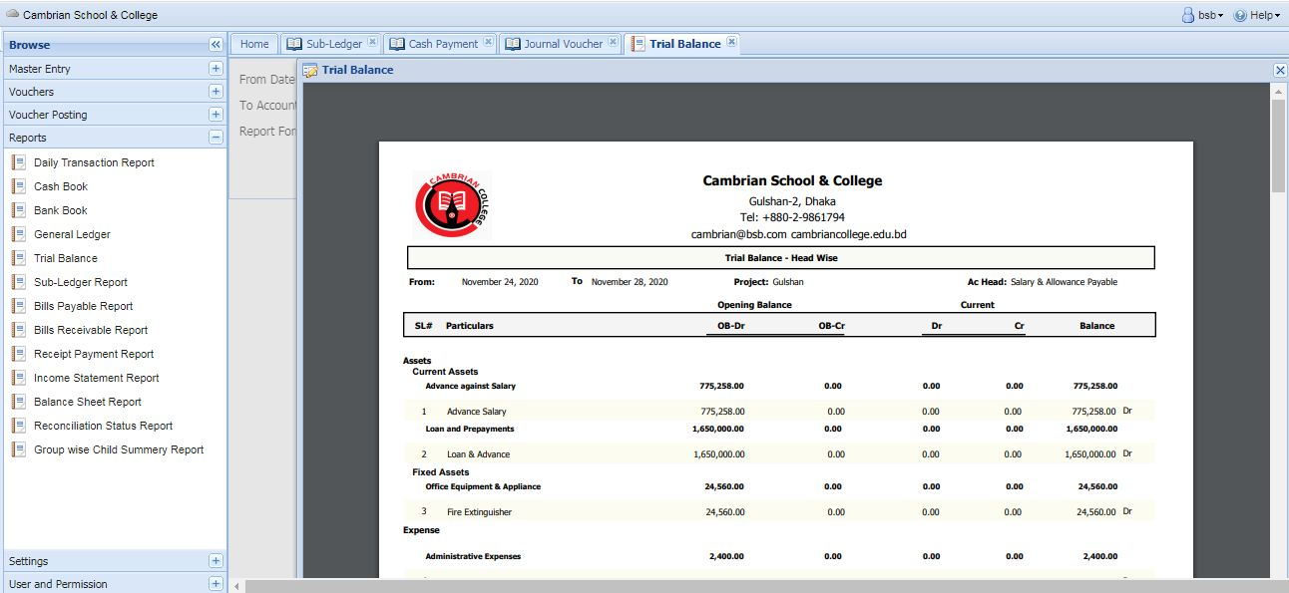
Reports (Trial Balance)

Slide 41

Our Proposal & Conclusion
Our Proposal is simple that we would highly appreciate the opportunity to cooperate your management digitizing your whole Institution starting from Result Processing to Online Tuition Fees collection System with utmost dedication and sincerity.
Our principal focus is to advantage the management of Schools and Colleges for conducting their administrative or academic activities even more elegantly. We recognize about the excellence and importance of educational institutions of our country and strongly believe that our system will be obliging and well effective that will upkeep them meeting their mission and vision. The system would not only reduce the paper work and physical labor but also will save time and money with bringing efficiency in both academic and administrative activities. In Bangladesh, our customizable dynamic features has already gained client’s boundless satisfaction and reliance that gives us huge confidence and encouragements.

Slide 42
Our Contact Information
Website: vividinternational.net
Email: info@vividinternationalnet
Thank You

